Slide 1
Increasing Adoption and Varietal Turnover of Seed—Consumer and Producer Side Interventions
Bjorn Van Campenhout

Slide 2
Structure of this presentation
Overview of new study in Uganda that aims to varietal turnover of seed
Producer Side Intervention
Consumer Side Intervention
Additional research question added onto producer side intervention
Zoom in on “additional research question” and look at some analysis of baseline data
Bargaining for seed and the role of the initial offer price

Slide 3
Background
In the next few decades, more food needs to be grown on less land – especially in SSA
Improved seed varieties (open pollinated varieties, hybrid seed or even GMOs) are a large part of the solution (eg green revolution)
SSA is seriously lagging in the adoption – farmers stick to "landraces" despite potential yield increase of +100 %
MIPPI work package: how to increase varietal turnover
Cross country RCT with teams doing similar interventions in Ethiopia, Nigeria, Kenya, and India

Slide 4
Q1: Can we increase adoption by seed trial packs
Subsidies are popular intervention to introduce a new agricultural technology
Overcome reluctance related to risk
Kickstart adoption among the poor
Leverage potential learning externalities (optimal pigouvian subsidy)
Injecting new seed varieties in seed stock
Some studies on effectiveness of seed trial packs, but many focus on use of trial pack and (intention to) use of promoted variety in next season <> main outcome is impact in subsequent season (incl actual adoption and yield)

Slide 5
Q2: Can we increase adoption via cooking demonstrations/blind tasting/flour trial pack
Most efforts to increase adoption focus on production traits (yield, drought tolerance) <> Consumption traits (palatability, aroma,…) much less used to convince farmers to grow new crops (despite the fact that most farmers are self-subsistance farmers)
Treatment : Farmers are invited to a cooking demonstration and tasting session of maize flour obtained from maize of an improved seed variety
Note: Potentially interesting gender effects

Slide 6
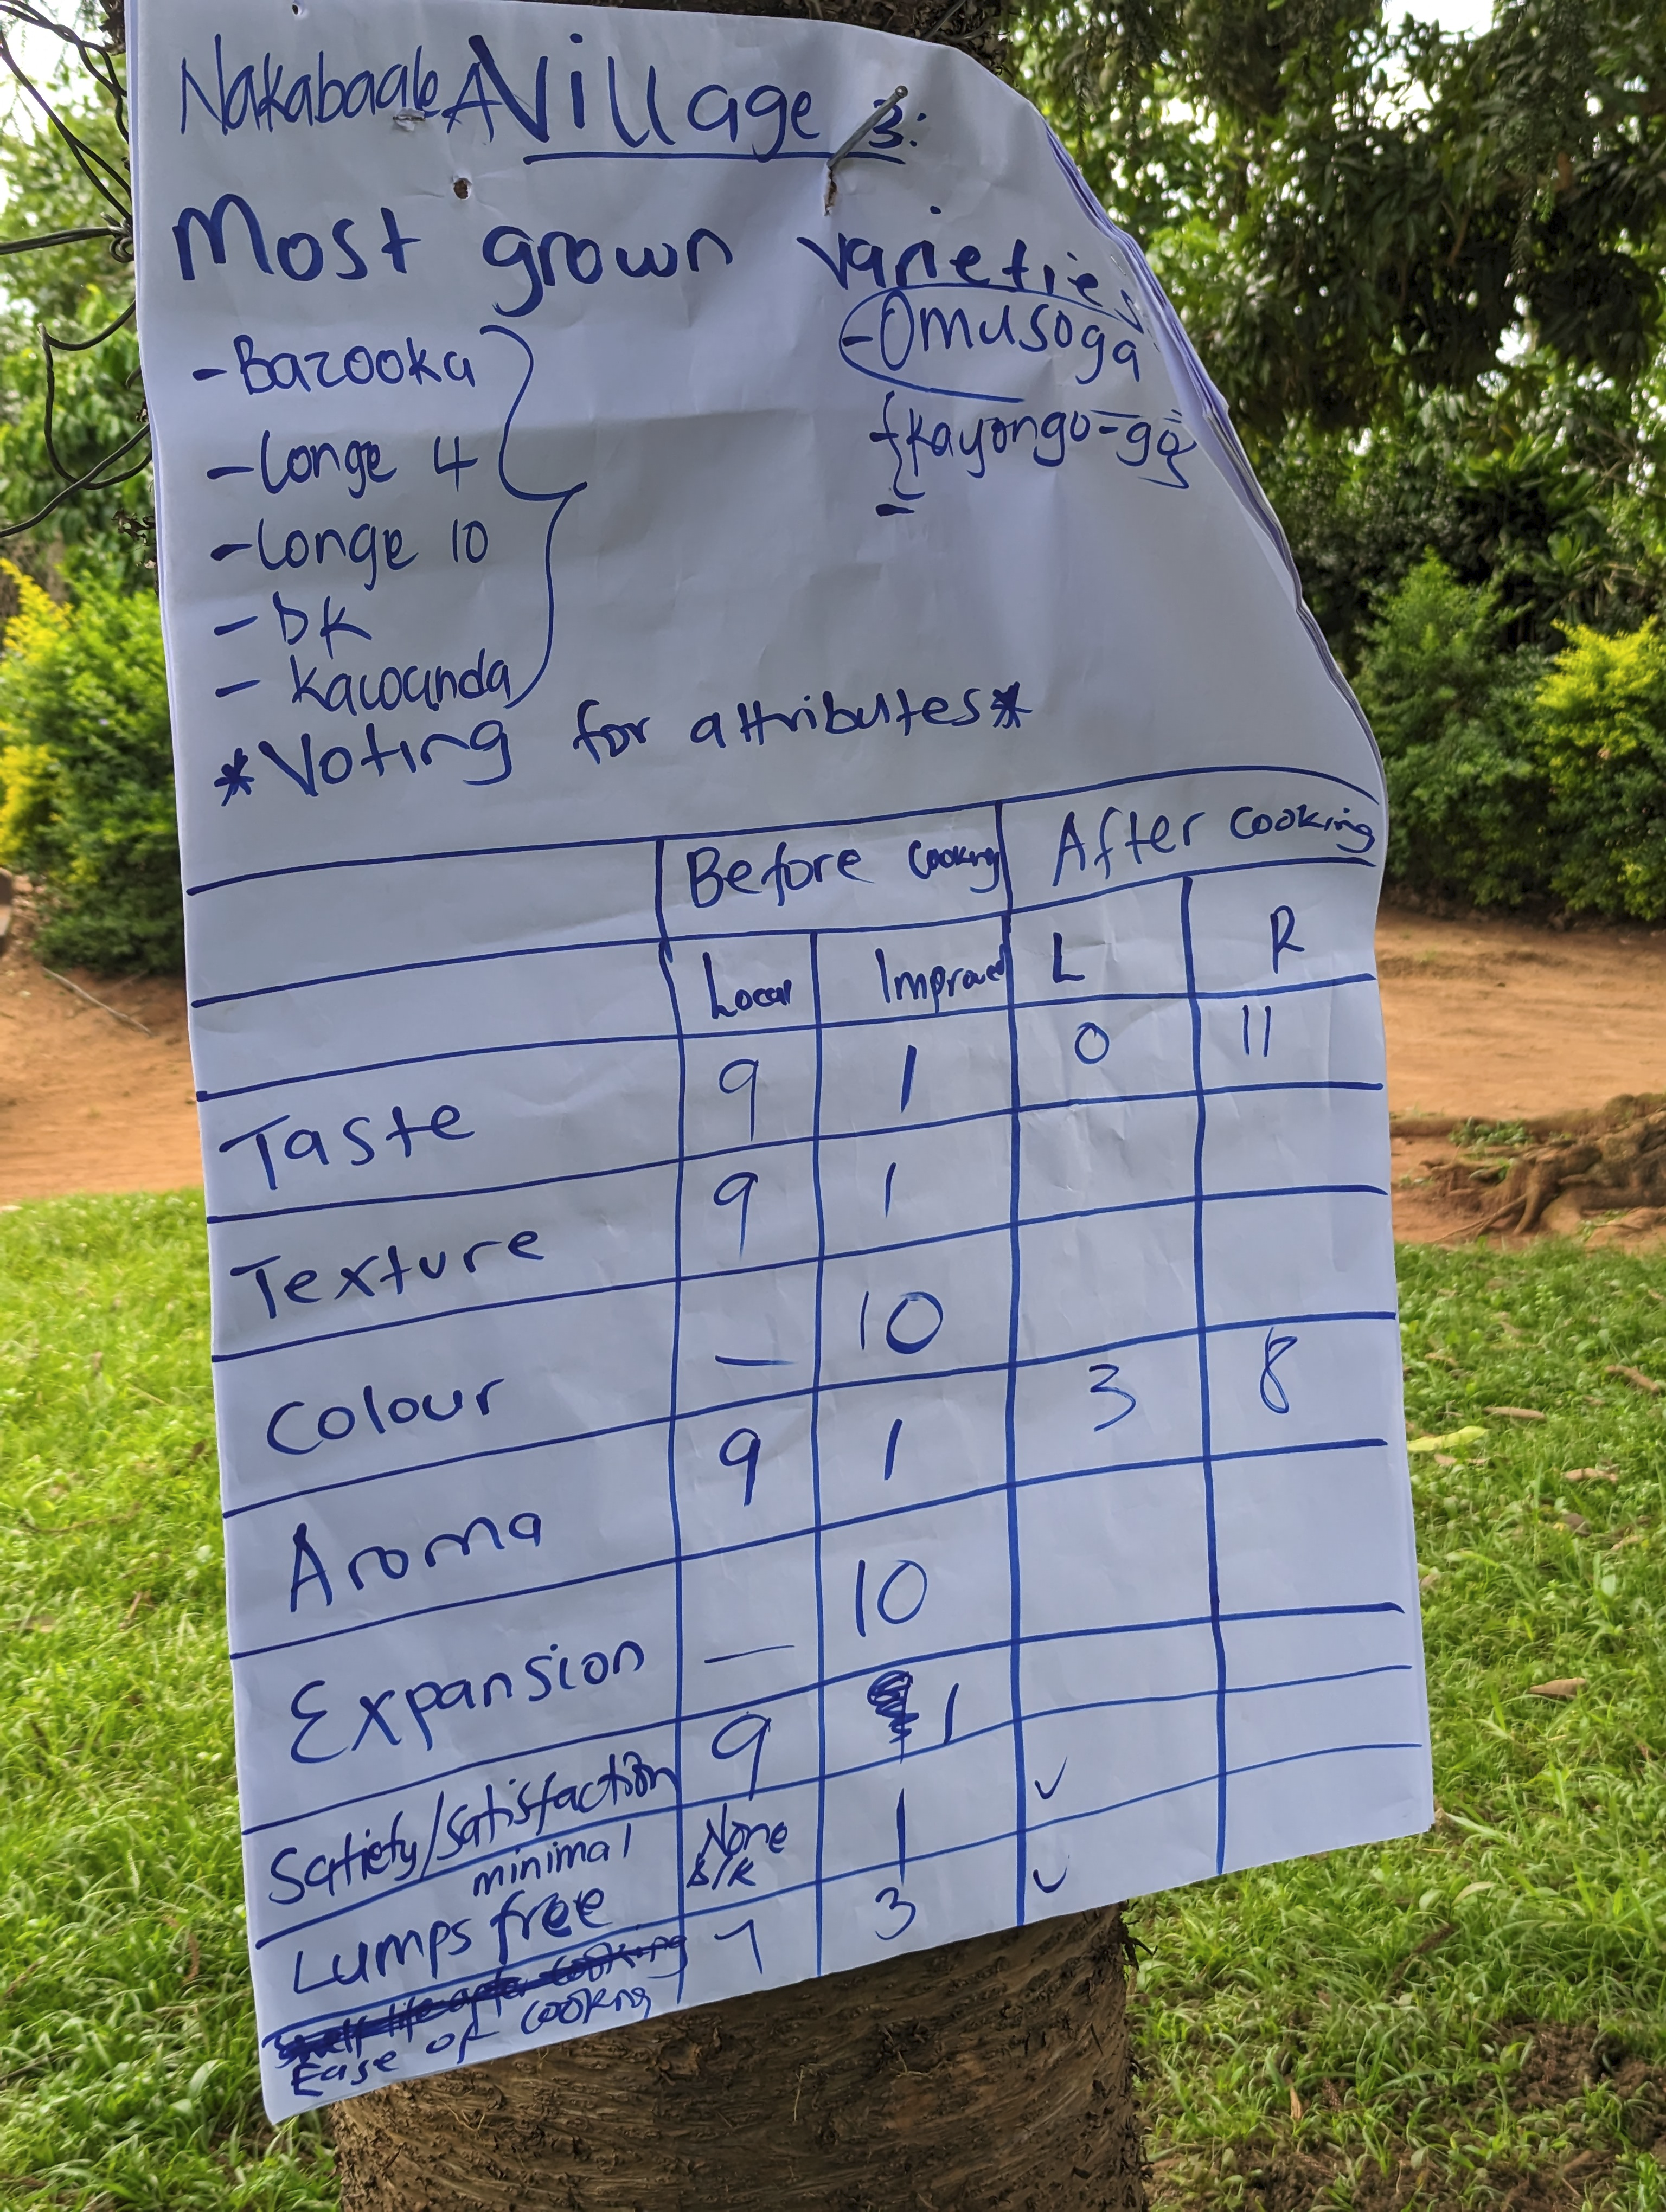
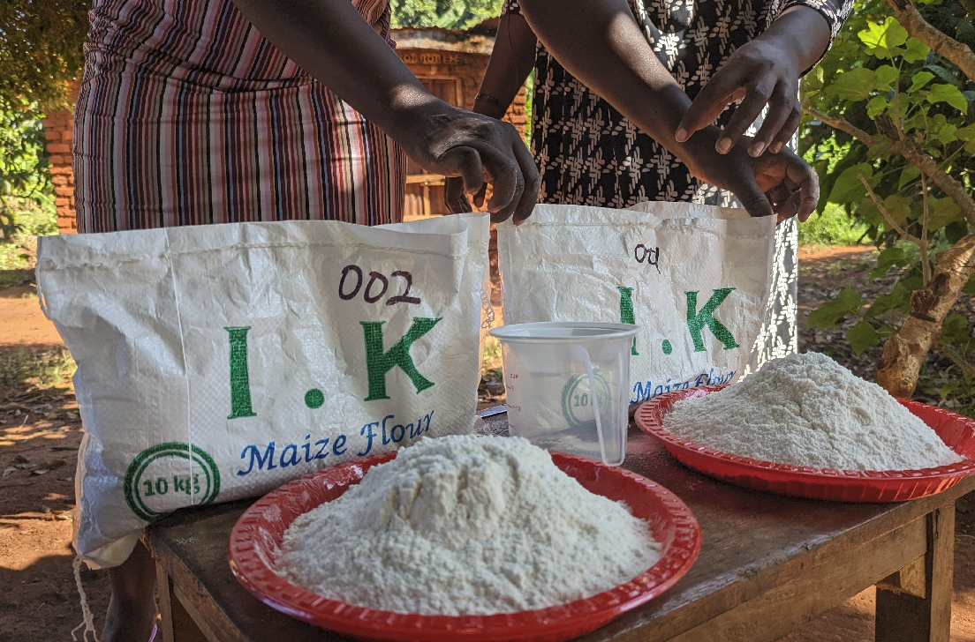
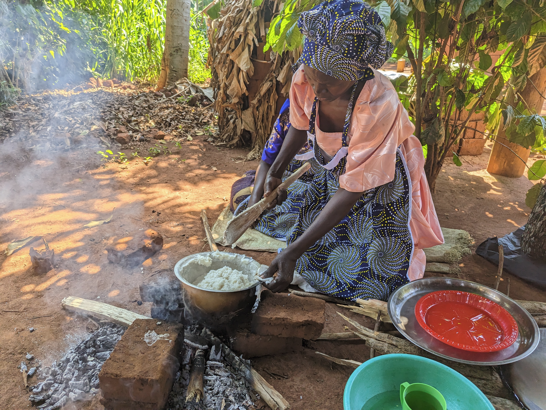
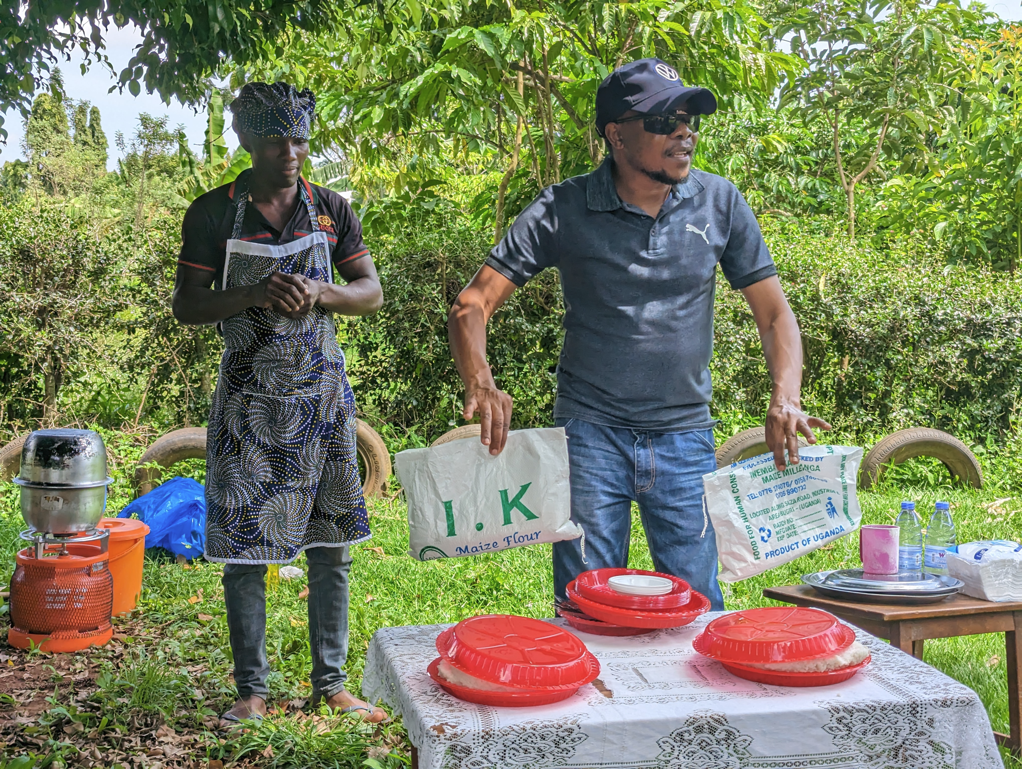
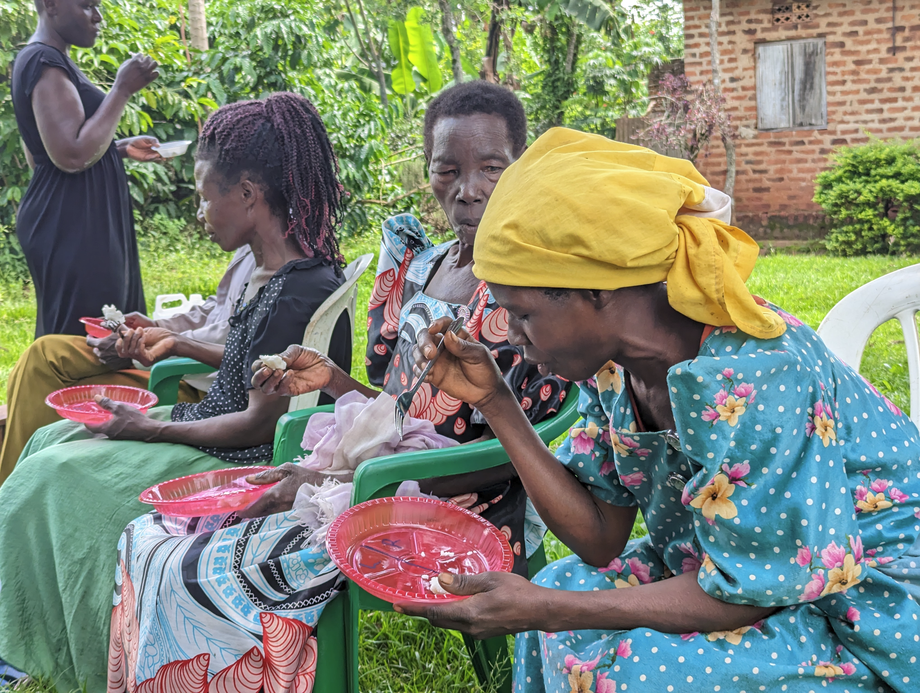
Q2: Piloting cooking demonstrations/blind tasting/flour trail pack

Slide 7
Q3: Do people learn less if they get stuff for free
Free things are not valued as much as things you need to pay for
Two effects:
screening effect: charging a positive price could select out those who do not value the good and place it only in the hands of those who are likely to use it
Sunk cost effect: a psychological effect whereby paying a positive price for a good could induce people to use it more, regardless of how much they value it
Problem: how to disentangle these two effects?
A two-stage pricing design where you first ask farmers to pay a price (offer price) and then give them a surprise reduction (leading to a transaction price) – then run a) regression to look at effect of offer price keeping transaction price constant and b) run regression to look at effect of transaction price keeping offer price constant

Slide 8
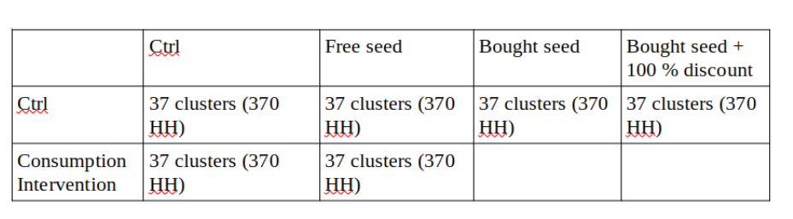
Experimental design

Slide 9
Timeline
January 2023 – baseline done + distribution of trial packs (free, paid for, and discounted)
farmers plant in March, harvest in July
July 2023 – implement consumption intervention
August 2023 - partial midline (focus on use of trial packs)
farmers plant in August, harvest in January 2024
February 2024 – endline data collection

Slide 10
Two-stage pricing designs
Offer farmers opportunity to buy (perhaps at subsidized prices p) and then provide a random discount (d) (Cohen and Dupas 2010; Ashraf, Berry and Shapiro 2010)
A Becker–DeGroot–Marschak (WTP) auction: where the farmer formulates a bid that is compared to a price determined by a random number generator. If the subject's bid is greater than the price, they pay the price and receives the item being auctioned. If the subject's bid is lower than the price, they pay nothing and receive nothing.
We: a 2-player sequential bargaining game (with a concessional script) with 780 farmers

Slide 11
2-player sequential bargaining game
Trained enumerator offers a bag of seed for sale at initial (random) price (offer price). Farmer can accept or not. If not, farmer is invited to name their price (bid price).
If difference between offer price and bid price =< 500, sell at bid price
If difference between offer price and bid price > 500, new offer price = farmer's last bid price plus 80 percent of the difference between the last ask price and the farmer's last bid price

Slide 12
Incentive compatibility
Farmers were bidding for real seed which they got to take home at price that emerged from bargaining
Farmers did not know the algorithm
Sellers were also incentivized: the money they collect from farmers by selling seed was put in a pot and paid out to enumerators at the end of the fieldwork
Subgroup of farmers gets a surprise 100 % discount (unknown in advance to farmers and enumerators)

Slide 13
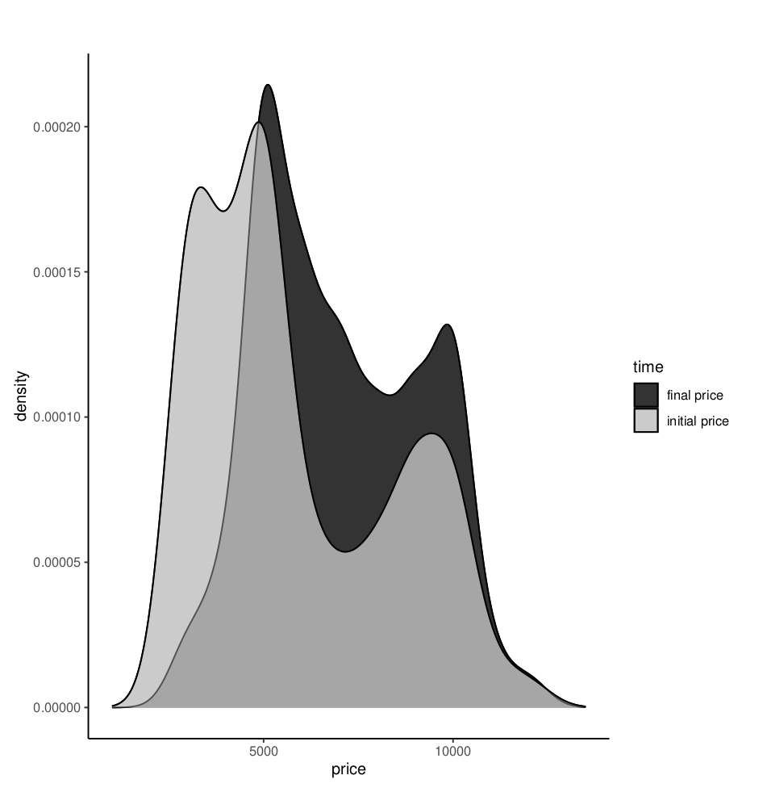
Results – initial bid price and final price
Initial price: mean 5840
Final price: mean 7012

Slide 14
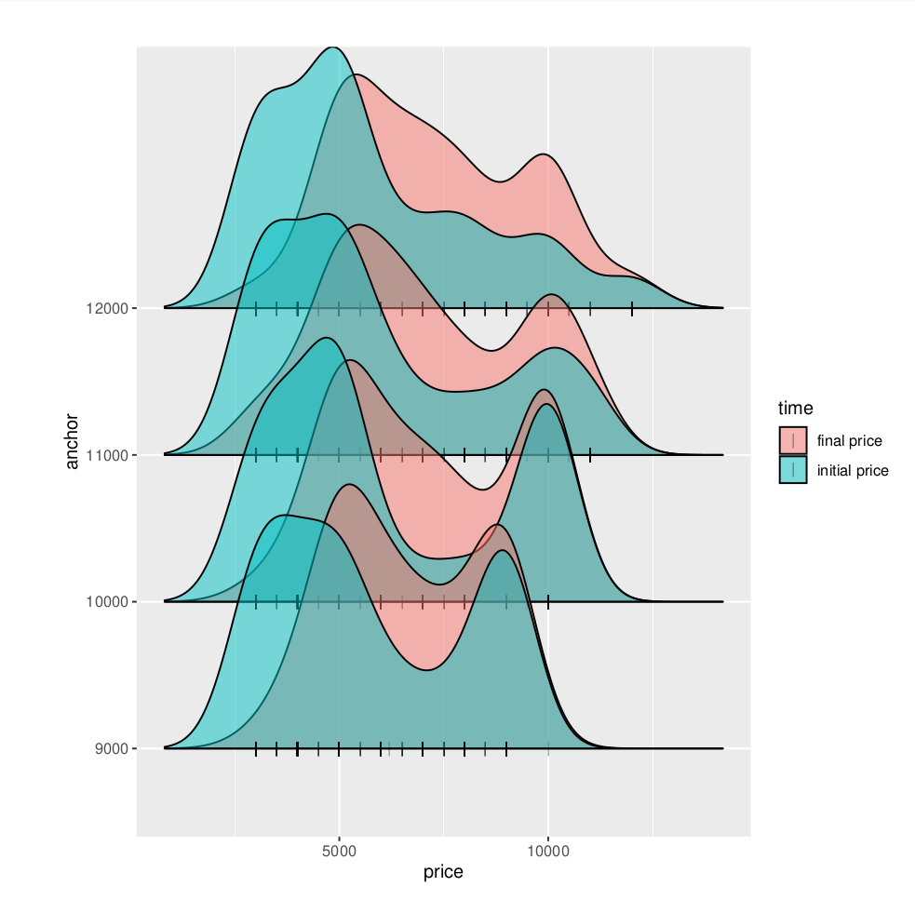
Results – initial bid price and final price by initial (randomized) offer price

Slide 15
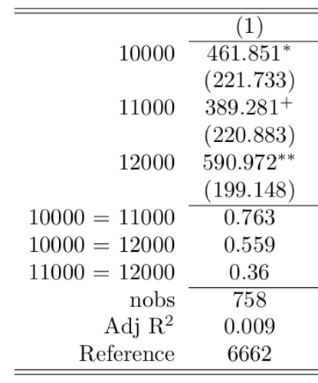
Results – effect of initial offer on final price

Slide 16
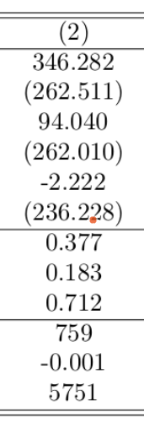
Results – effect of initial offer on initial counter bid

Slide 17
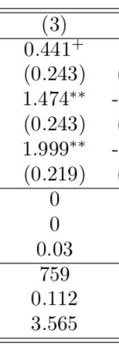
Results – effect of initial offer on number of negotiation rounds

Slide 18
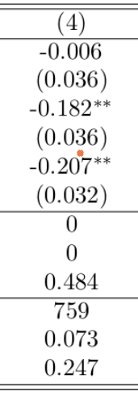
Results – effect of initial offer on likelihood that farmer accepts immediately

Slide 19
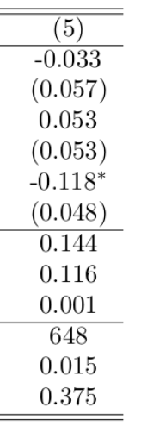
Results – effect of initial offer on fixed bid strategy

Slide 20
To be continued...

